Slide 1
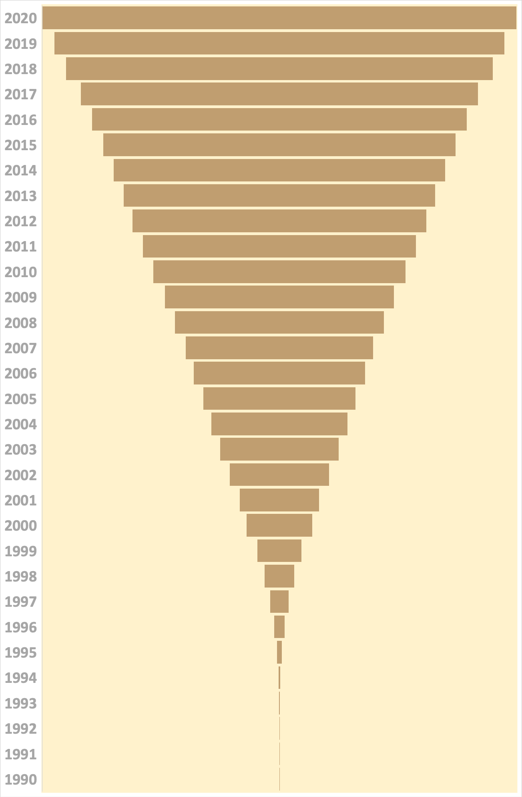


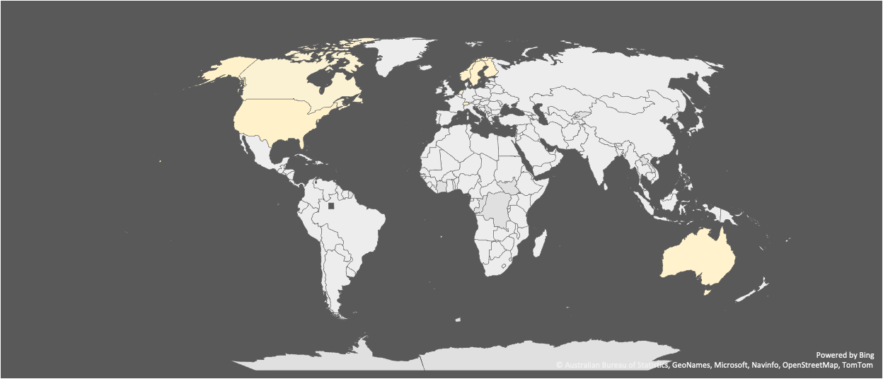
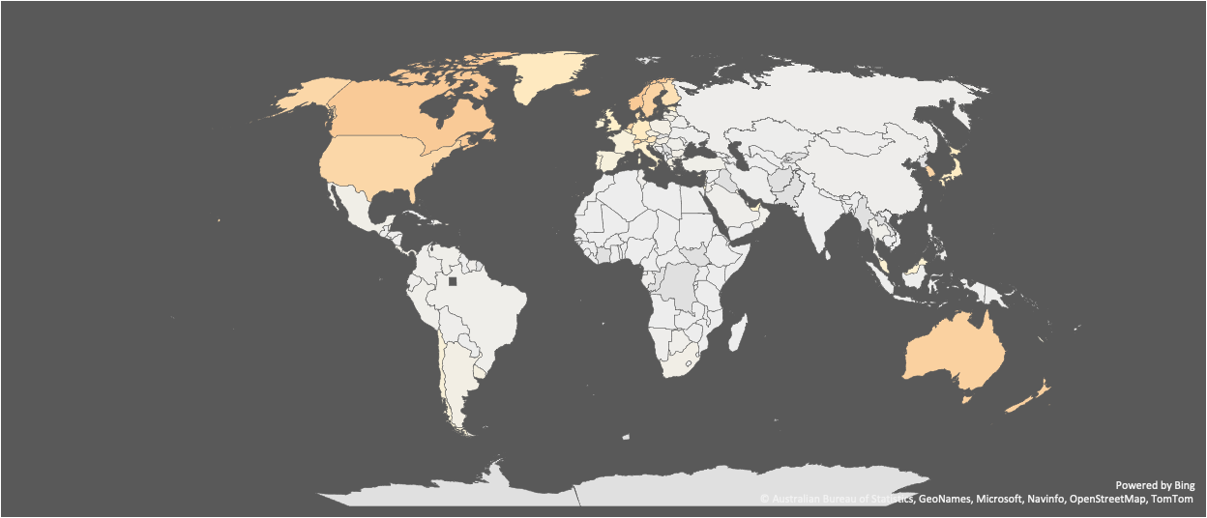
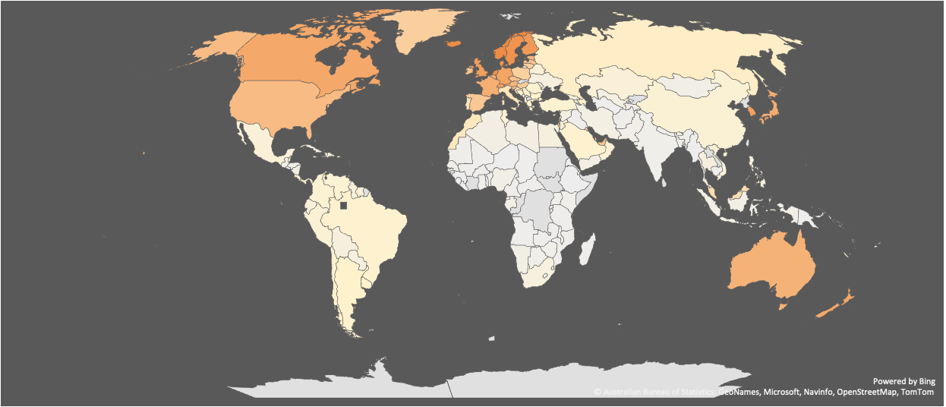

Internet Users over the years & around the world
%usage in
Europe
Americas
Oceania
Asia
Africa
WORLD
1990 | 1991 | 1993 | 1992 | 1994 | 1995 | 1996 | 1997 | 1998 | 1999 | 2000 | 2001 | 2002 | 2003 | 2004 | 2005 | 2006 | 2007 | 2008 | 2009 | 2010 | 2011 | 2012 | 2013 | 2014 | 2015 | 2016 | 2017 | 2018 | 2019 | 2020
Year-on-year increase
2.15
MOST coverage in Europe
0.0 | 0.1 | -0.1 | 0.2 | 0.4 | 0.8 | 1.1 | 1.5 | 2.0 | 3.0 | 1.8 | 2.8 | 2.6 | 2.4 | 2.3 | 2.6 | 2.2 | 3.0 | 2.7 | 3.2 | 2.9 | 2.8 | 2.4 | 2.7 | 2.9 | 3.1 | 3.0 | 4.1 | 3.1 | 3.3
Trend over the decades
1990 | 1991 | 1993 | 1992 | 1994 | 1995 | 1996 | 1997 | 1998 | 1999 | 2000 | 2001 | 2002 | 2003 | 2004 | 2005 | 2006 | 2007 | 2008 | 2009 | 2010 | 2011 | 2012 | 2013 | 2014 | 2015 | 2016 | 2017 | 2018 | 2019 | 2020
1990
2000
2010
2020
USA, Europe & Oceania regions are the first ones to adopt internet
Regions other than USA, Europe & Oceania are yet to pick up
Asia & South America are slowly picking up while usage in USA, Europe & Oceania regions is on the rise
Africa is picking up while the rest of the world is surging ahead

Slide 2
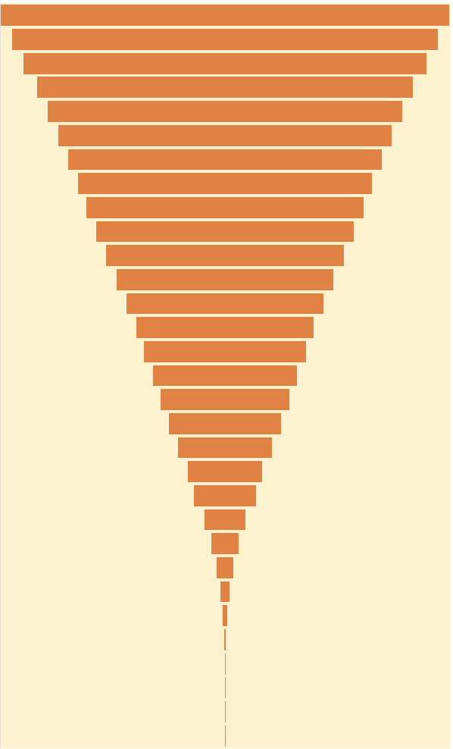

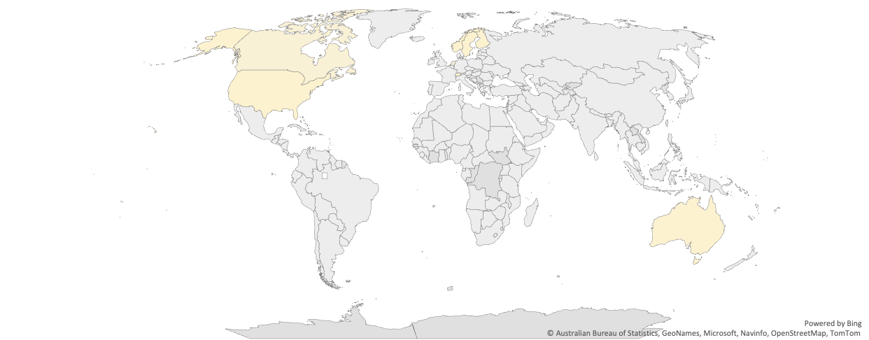
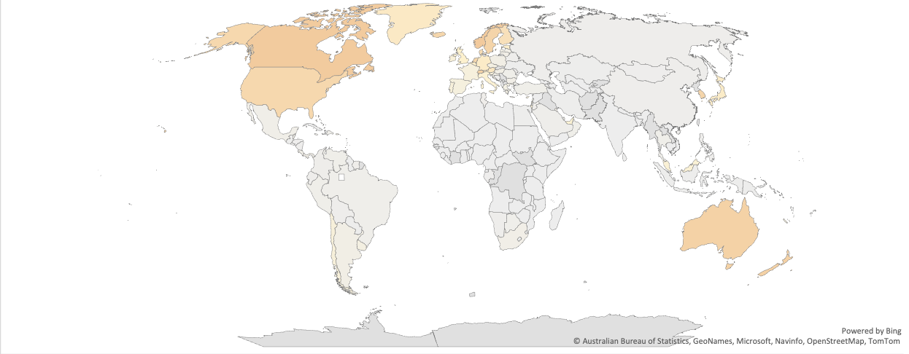
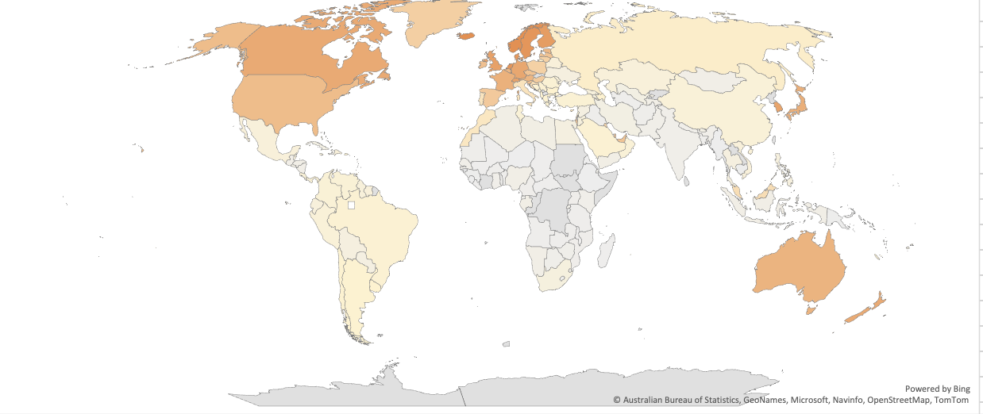
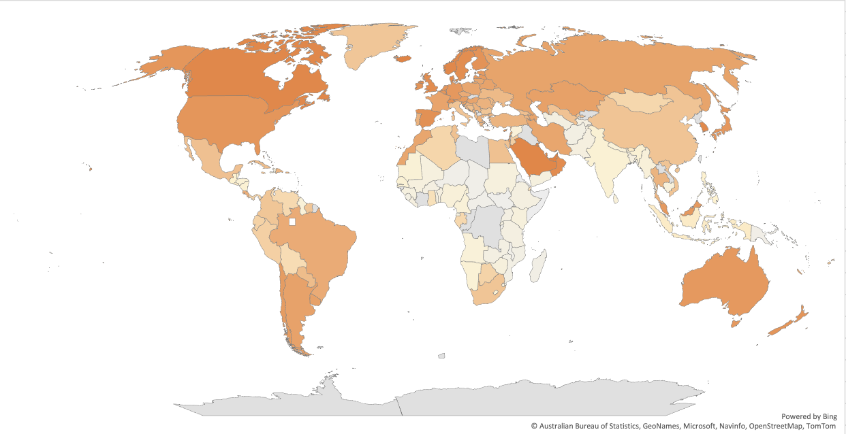
Internet Users over the years & around the world
1990 | 1991 | 1993 | 1992 | 1994 | 1995 | 1996 | 1997 | 1998 | 1999 | 2000 | 2001 | 2002 | 2003 | 2004 | 2005 | 2006 | 2007 | 2008 | 2009 | 2010 | 2011 | 2012 | 2013 | 2014 | 2015 | 2016 | 2017 | 2018 | 2019 | 2020
2.15%
Year-on-year increase
0.0 | 0.1 | -0.1 | 0.2 | 0.4 | 0.8 | 1.1 | 1.5 | 2.0 | 3.0 | 1.8 | 2.8 | 2.6 | 2.4 | 2.3 | 2.6 | 2.2 | 3.0 | 2.7 | 3.2 | 2.9 | 2.8 | 2.4 | 2.7 | 2.9 | 3.1 | 3.0 | 4.1 | 3.1 | 3.3
% population
MOST coverage in Europe
LEAST coverage in Africa
Europe
Americas
Asia
Oceania
Africa
Trend over the decades
1990
2000
2010
2020
USA, Europe & Oceania regions are the first ones to adopt internet
Regions other than USA, Europe & Oceania are yet to pick up
Asia & South America are slowly picking up while usage in USA, Europe & Oceania regions is on the rise
Africa is picking up while the rest of the world is surging ahead

